Slide 1

An Individual Participant Data Meta-Analysis of the Machine Learning Models in Predicting Customer Churn
Sciences Building | August 30, 2024

Slide 2
Research Motivation & Objectives
Highly competitive business environment
Existing studies show substantial differences in churn prediction results.
Need for a comprehensive analysis of models’ performance across industries.
Research Goal: Employ an Individual Participant Data Meta-Analysis (IPD-MA) to enhance the understanding of ML model performance across different contexts.
Notes:
Since the business environment is highly competitive, companies leverage data-driven strategies to stay competitive, focusing on customer retention alongside acquisition.
Existing studies show substantial differences in churn prediction results due to various factors like dataset characteristics and industry specifics.
Need for Comprehensive Analysis: Utilizing diverse ML techniques and public datasets to evaluate model performance across industries.
Research Goal: Employ an Individual Participant Data Meta-Analysis (IPD-MA) to address inconsistencies and enhance the understanding of model performance across different contexts.

Slide 3
Background
Saradhi et al. (2011) - employee churn
Qureshi et al. (2013) - customer DNA website dataset
Sisodia et al. (2017) - HR analytics dataset.
Ahmad et al. (2019) - SyriaTel telecom company
Rahman and Kumar (2020) - commercial bank
Lalwani et al. (2022) - telecom sector
Geiler et al (2022) compared the performance of various ML algorithms on several public datasets
Notes:
Saradhi et al. (2011) reviewed three machine learning techniques in the employee churn context.
Qureshi et al. (2013) used logistic regression, decision trees, and artificial neural networks to predict potential Customer DNA website dataset churners.
Sisodia et al. (2017) used five machine learning algorithms—linear SVM, decision tree, random forest, k-nearest neighbor, and naive Bayes classifier—to build a model for predicting the churn rate for an HR analytics dataset.
Ahmad et al. (2019) developed a churn prediction model using a dataset from SyriaTel telecom company.
Rahman and Kumar (2020)’s paper focuses on predicting customer churn in a commercial bank. It discusses data transformation and classification techniques such as k-nearest neighbor, support vector machine, decision tree, and random forest.
Lal-wani et al. (2022) utilized a range of predictive models, including logistic regression, Naïve Bayes, support vector machine, random forest, decision trees, boosting, and ensemble approaches, to forecast customer turnover in the telecom sector.
Geiler et al (2022) compared the performance of various ML algorithms on several public datasets

Slide 4
Background
Meta-analysis (MA) - statistical methods to combine and summarize the results of several independent studies
Provide a pooled estimate of the effect size of specific intervention or exposure
MA rooted in the synthesis of the effectiveness of medical and psychological interventions in the 1970s (Glass 2015, Gurevitch et al. 2018)
MA is of increasing importance in management research & related fields:
Bergh et al.2016, Combs et al. 2019 - general management
Havranek et al. 2020 - in economics and finance
DeSimone et al. 2020 - organizational studies
Steel et al. 2021 - international business
Notes:
Systematic review and statistical methods to combine and summarize the results of several independent studies
Provides precise estimate of the effect size of specific intervention or exposure, by pooling results of multiple studies that investigated the same research question
Meta-analysis rooted in the synthesis of the effectiveness of medical and psychological interventions in the 1970s (Glass 2015, Gurevitch et al. 2018)
Meta-analysis is of increasing importance in management research & related fields:
Bergh et al.2016, Combs et al. 2019 - general management
Havranek et al. 2020 - in economics and finance
DeSimone et al. 2020 - organizational studies
Steel et al. 2021 - international business

Slide 5
Background
Existing studies show substantial differences in churn prediction results.
This study aims to generalize and enhance the understanding of ML model performance across different contexts.
Extend the application of the IDP-MA method to a new domain.

Slide 6
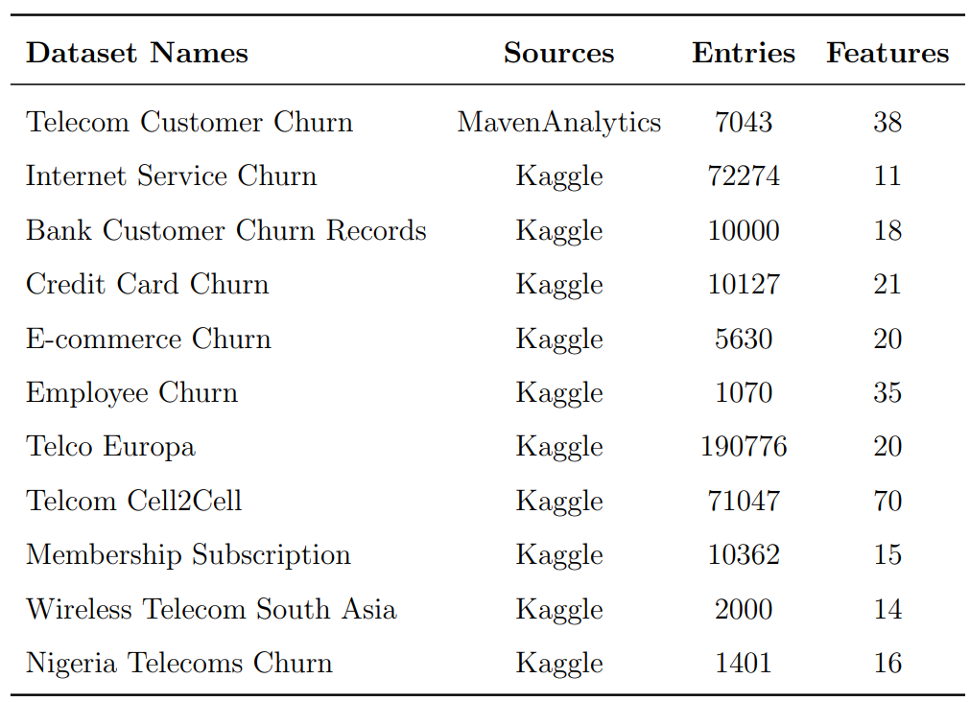
Datasets

Slide 7
Methodology
Individual Dataset - EDA & Processing
Interpret the results
Individual Dataset - ML Models Evaluation
Residual Heterogeneity Estimates
Aggregated Metrics Mean & Standard Error by ML Models and by Datasets
Estimate Pooled and CI of Effect Size by Using Fixed & Random Effect Methods

Slide 8
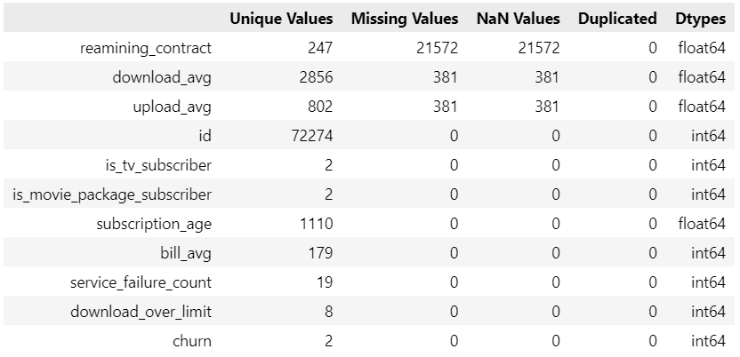
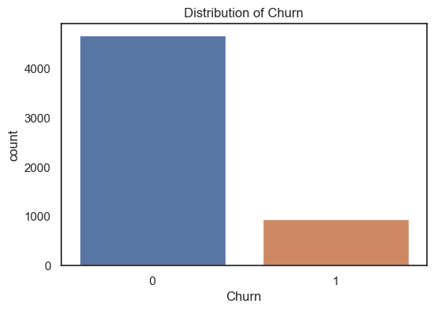
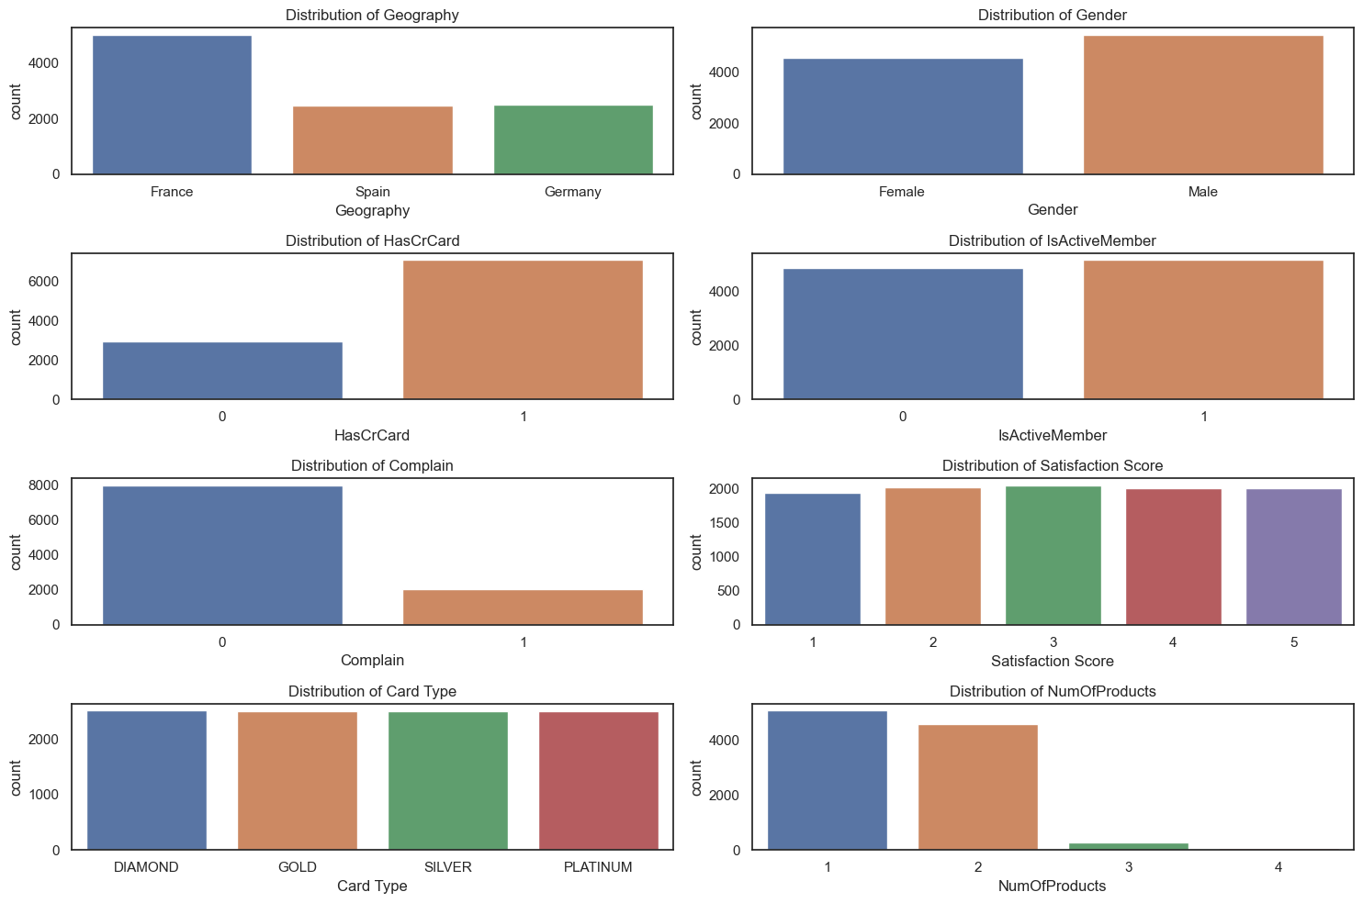
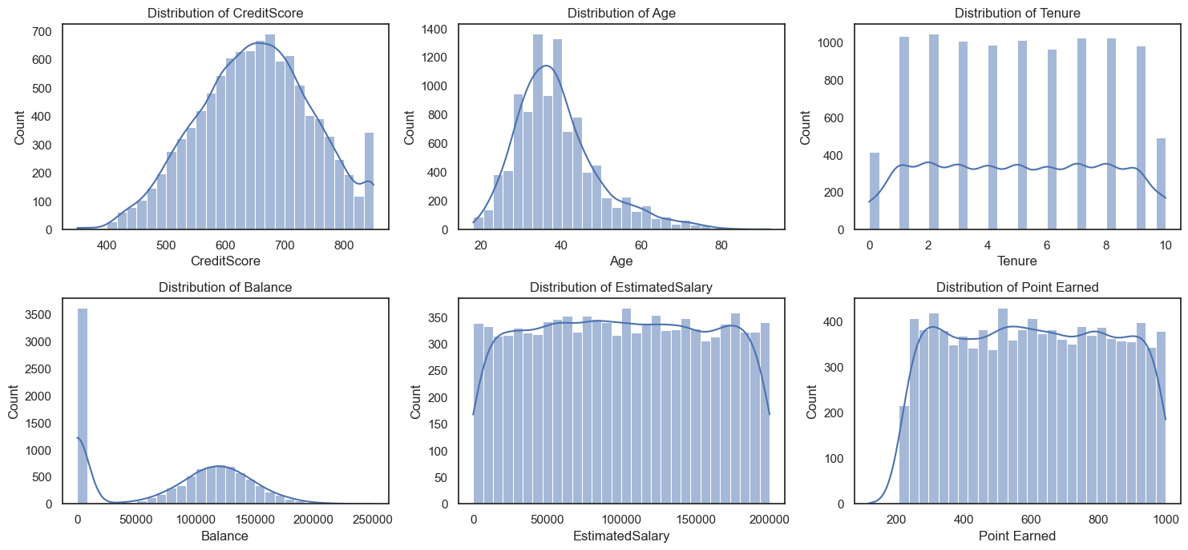
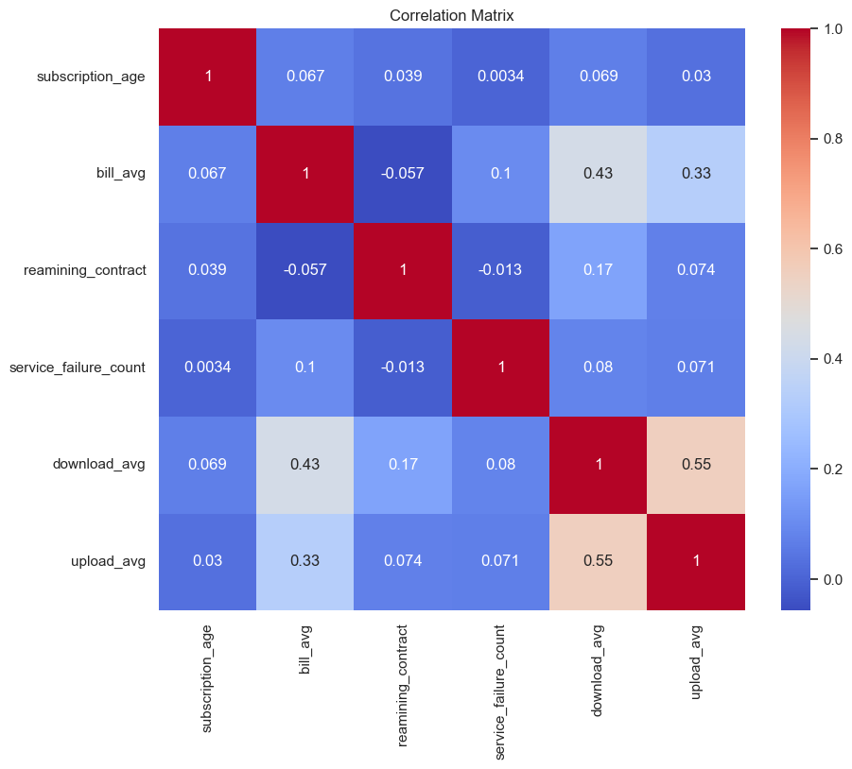
Methodology
Exploratory Data Analysis
Notes:
EDA example of bank churn dataset

Slide 9
Methodology
Data Processing
Train test data splitting
Remove non-informative or directed churn-related features
Data Encoding
Missing Data Handling
Data Scaling
Notes:
The original dataset was stratified split into 75% for train and 25% for test
Some non-informative or directed churn-related features were removed
Categorical missing data were filled by respected most frequent values
Numerical missing data were filled by respected mean values
Standard scaling was applied for numerical features
Categorical variables were applied one-hot encoder

Slide 10
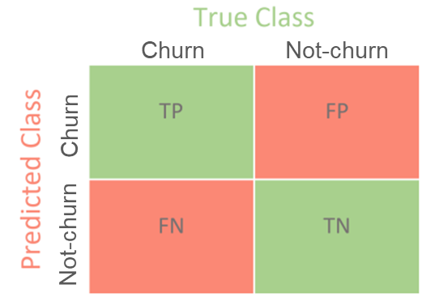
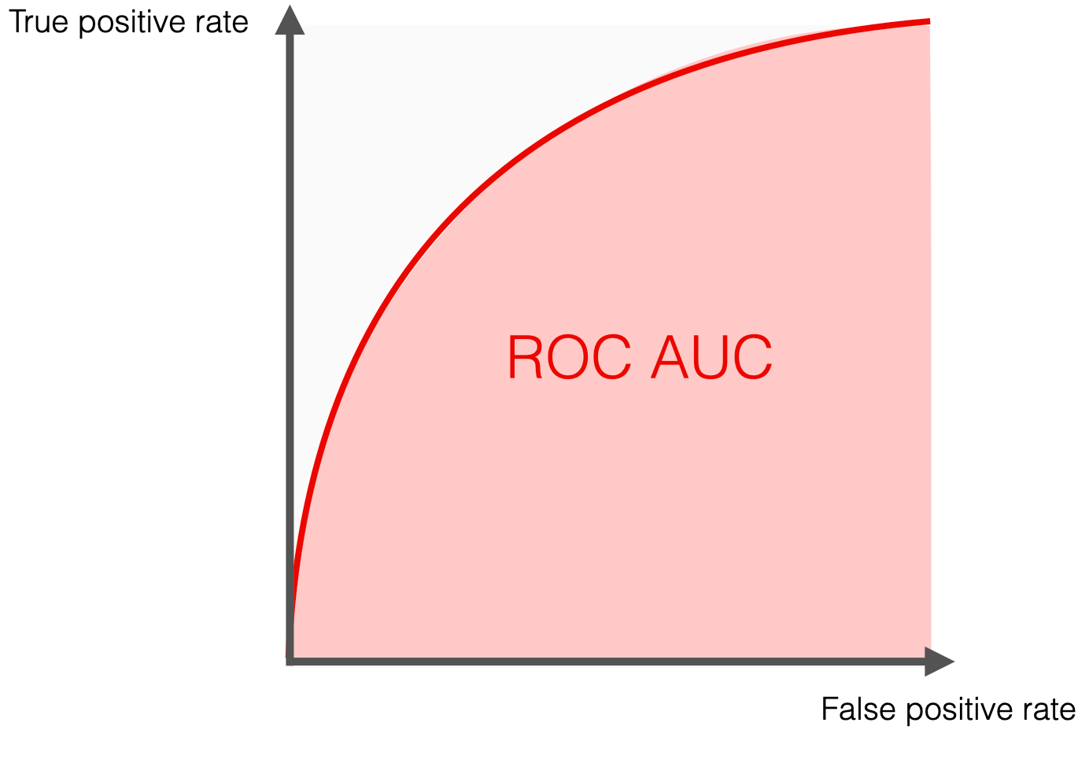
Methodology
Model Evaluation Metrics
Accuracy, Precision, Recall, F1 Score, and ROC AUC
Notes:
Derived metrics from the Confusion Matrix were used for evaluation: Accuracy, Precision, Recall, F1 Score, and ROC AUC
The ROC curve is plotted with True Positive Rate (TPR, also known as sensitivity) on the y-axis against the False Positive Rate (FPR, 1-specificity) on the x-axis at various threshold settings.
TPR is calculated as TPR=TP/(TP+FN).
FPR is calculated as FPR=FP/(FP+TN)
The AUC value ranges from 0 to 1. A model with perfect prediction has an AUC of 1, which means it has a perfect ability to distinguish between positive and negative class points. An AUC of 0.5 suggests no discriminative ability, equivalent to random guessing.
A higher AUC value indicates better model performance, with a clearer ability to differentiate between the positive and negative classes across all possible classification thresholds.

Slide 11
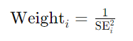
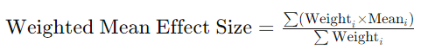
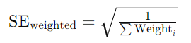
Methodology
Fixed-Effect Model
Step 1: Determine the weights for each study:
Step 2: Calculate the weighted mean effect size:
Step 3: Compute the SE of the weighted mean effect size:
Step 4: Calculate the 95% Confidence Interval:
Notes:
Under the fixed-effect model all studies in the analysis share a common true effect.
All observed dispersion reflects sampling error, and study weights are assigned to minimize this within-study error.
The summary effect is our estimate of this common effect size, and the null hypothesis is that this common effect is zero (for a difference) or one (for a ratio).

Slide 12
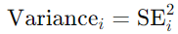
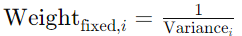
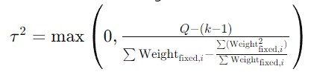
Methodology
Random-Effect Model
Step 1: Calculate Individual Study Variances:
Step 2: Calculate Weights for Fixed-Effect Model:
Step 3: Estimate Between-Study Variance (Tau-squared, τ2):
where:
Notes:
Under the random-effects model, the true effects in the studies are assumed to have been sampled from a distribution of true effects.
The summary effect is our estimate of the mean of all relevant true effects, and the null hypothesis is that the mean of these effects is 0.0 (equivalent to a ratio of 1.0 for ratio measures).
Since our goal is to estimate the mean of the distribution, we need to take account of two sources of variance. First, there is within-study error in estimating the effect in each study. Second (even if we knew the true mean for each of our studies), there is variation in the true effects across studies. Study weights are assigned with the goal of minimizing both sources of variance.

Slide 13
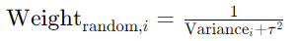
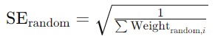
Methodology
Random-Effect Model
Step 4: Calculate Weights for Random-Effects Model:
Step 5: Calculate the Weighted Mean Effect Size:
Step 6: Compute the Standard Error of the Weighted Mean Effect :
Step 7: Calculate the 95% Confidence Interval:

Slide 14
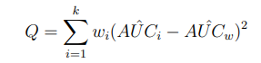
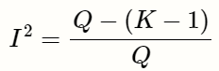
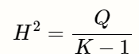
Methodology
Residual Heterogeneity Estimate
Q-statistic tests for heterogeneity
- Null hypothesis: all studies share a common effect size, no heterogeneity
- Alternative hypothesis: there is significant heterogeneity among studies
Notes:
In this context, the null hypothesis (H_o) is that all studies share a common effect size, suggesting no significant heterogeneity. The alternative hypothesis (H_a), on the other hand, proposes that there is significant heterogeneity, indicating that the variability among study estimates is not solely due to sampling error but also due to true differences in effect sizes.
The I2 statistic (J. P. Higgins and Thompson 2002) is another way to quantify between-study heterogeneity, and directly based on Cochran’s Q. It is defined as the percentage of variability in the effect sizes that is not caused by sampling error. I2 draws on the assumption that Q follows a χ2 distribution with K−1 degrees of freedom under the null hypothesis of no heterogeneity.
The H2 statistic (J. P. Higgins and Thompson 2002) is also derived from Cochran’s Q, and similar to I2. It describes the ratio of the observed variation, measured by Q, and the expected variance due to sampling error:

Slide 15
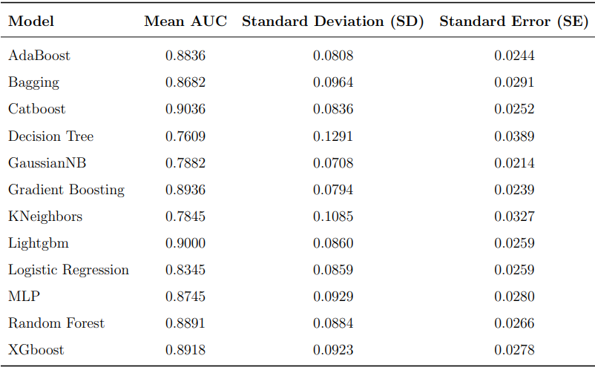
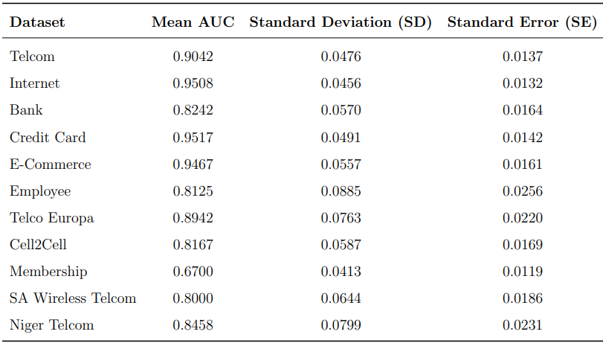
Results & Discussions
Effect Size and Standard Errors

Slide 16
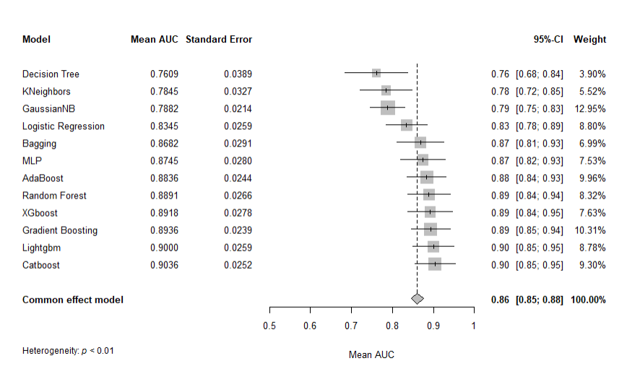
Results & Discussions
Fixed Effect Model Forests Plot by ML Models

Slide 17
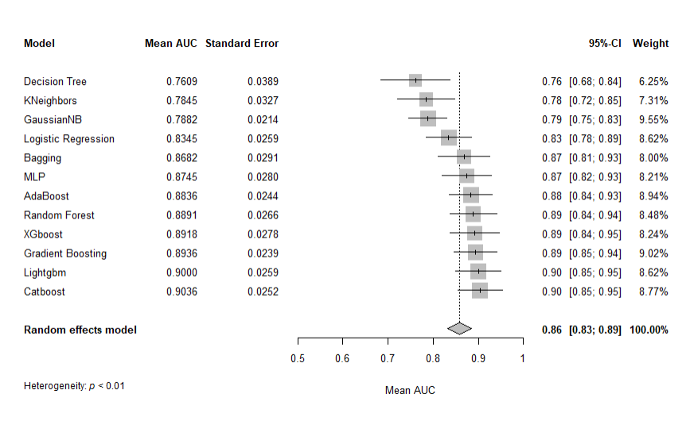
Results & Discussions
Random Effect Model Forests Plot by ML Models

Slide 18
Results & Discussions
Residual Heterogeneity Estimate – by Dataset
Test of Residual Heterogeneity
 | Q | df | p
 | 35.216 | 11 | 0.0002
Residual Heterogeneity Estimates
 | Fixed-model
τ² | 0.0072
τ | 0.0846
I² (%) | 68.76
H² | 3.20
Residual Heterogeneity Estimates
 | Random-model
τ² | 0.0016
τ | 0.0359
I² (%) | 68.57
H² | 3.18

Slide 19
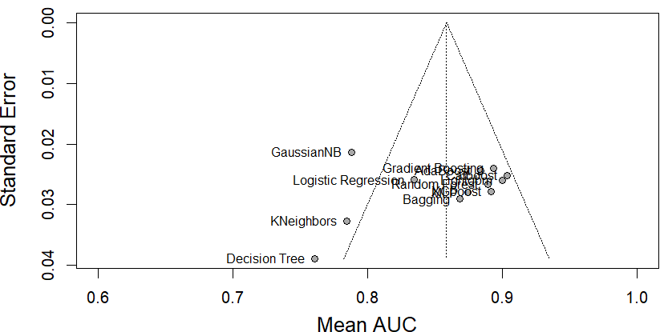
Results & Discussions
Funnel Plot by ML Models

Slide 20
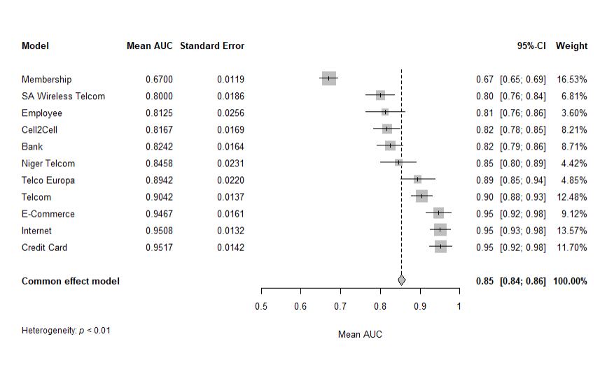
Results & Discussions
Fixed Effect Model Forests Plot by Dataset

Slide 21
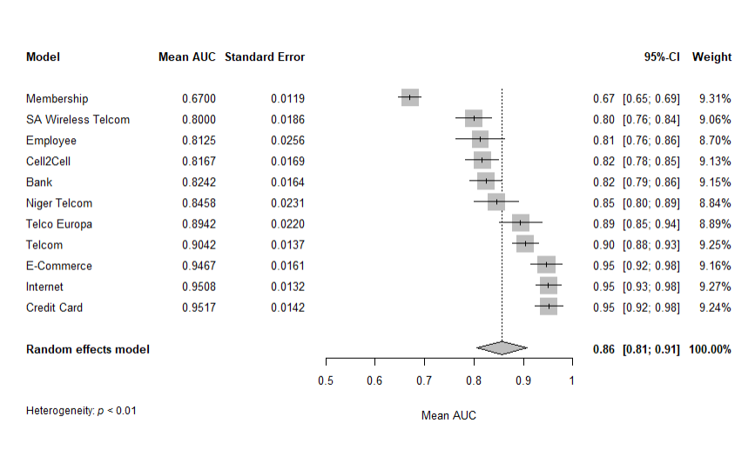
Results & Discussions
Random Effect Model Forests Plot by Dataset

Slide 22
Results & Discussions
Residual Heterogeneity Estimate – by Dataset
Test of Residual Heterogeneity
 | Q | df | p
 | 408.464 | 10 | 0.0001
Residual Heterogeneity Estimates
 | Fixed-model
τ² | 0.0072
τ | 0.0846
I² (%) | 97.55
H² | 40.85
Residual Heterogeneity Estimates
 | Random-model
τ² | 0.0072
τ | 0.0846
I² (%) | 96.44
H² | 28.13

Slide 23
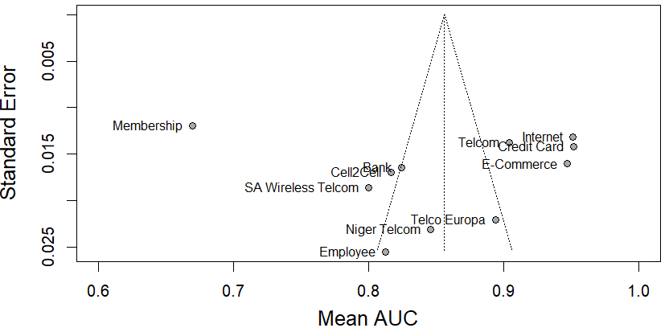
Results & Discussions
Funnel Plot by Dataset

Slide 24
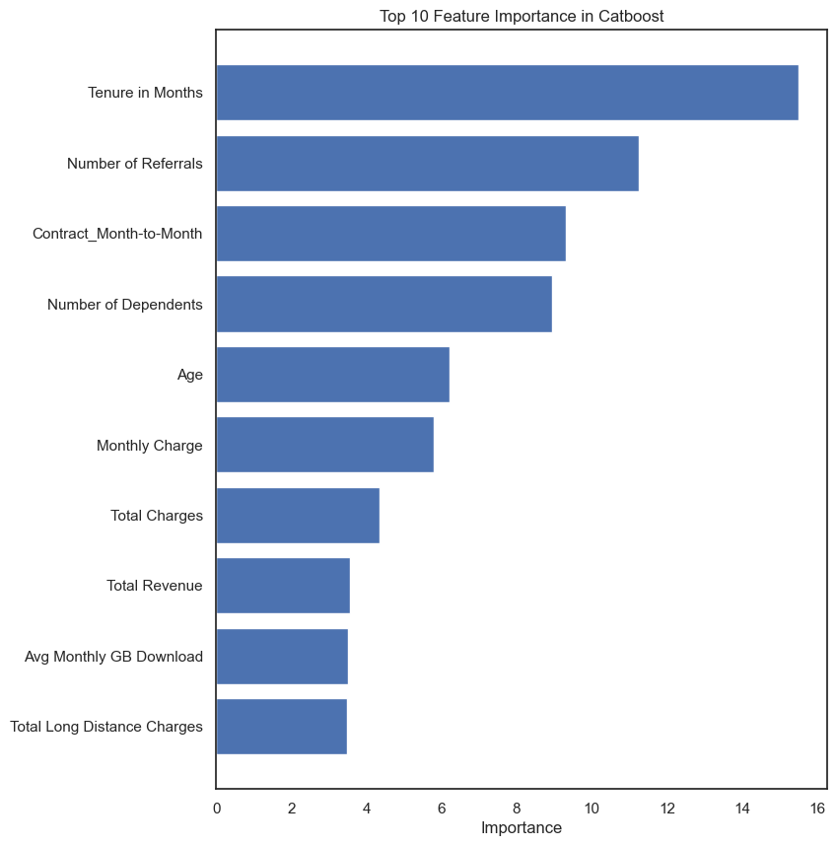
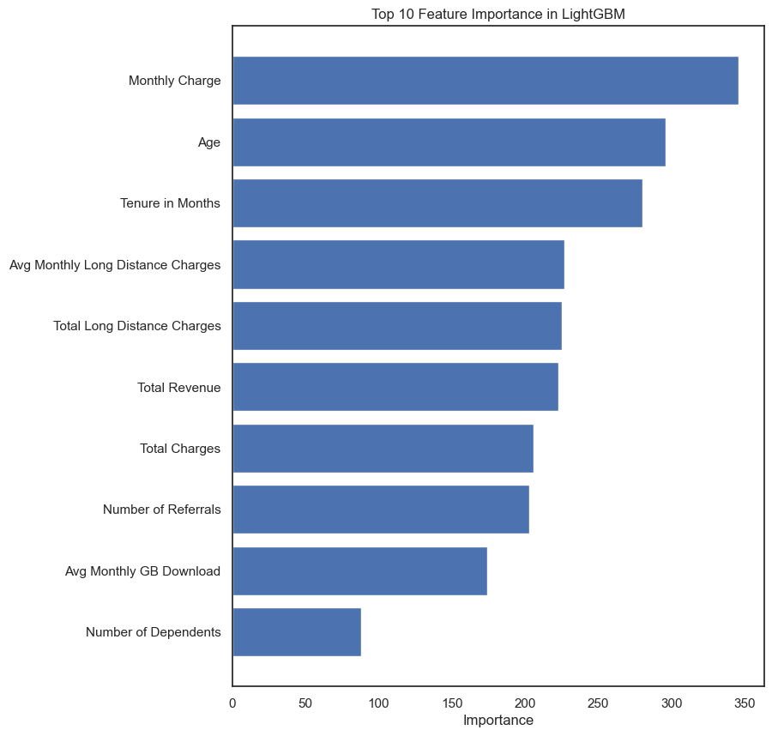
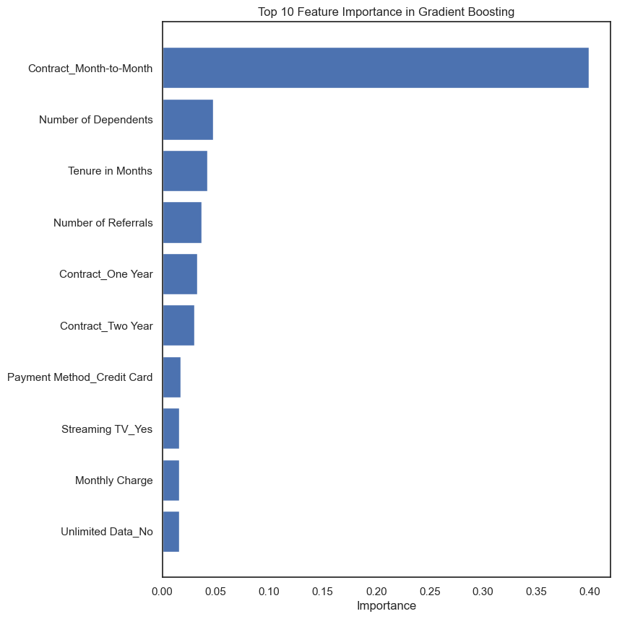
Results & Discussions
Feature Importance - Telcom Churn Dataset

Slide 25
Research Contribution
Employed IDP-MA approach in new domain
Comprehensive model performance analysis across different datasets provides a valuable reference for tackling similar prediction tasks in industry
The findings highlighted the importance of designing data acquisition
Notes:
By employing an IPD-MA approach, this study integrates raw data from multiple datasets, allowing for a more nuanced and robust comparison of machine learning models. This methodological advancement can be applied to other domains where meta-analysis of machine learning performance is required.
The detailed analysis of model performance across different datasets provides a valuable reference for tackling similar prediction tasks in industry
The research demonstrates the importance of accounting for heterogeneity in meta-analyses by comparing fixed-effect and random-effect models. This contribution is crucial for developing more reliable and generalizable predictive models in varied real-world scenarios.

Slide 26
Limitations and Future Research
Reliance on publicly available datasets
Employed a limited set of machine-learning models
Future research should aim to include a broader range of datasets and ML models
Notes:
Reliance on publicly available datasets means that the findings may not fully generalize to proprietary datasets with different characteristics
Employed a limited set of machine learning models and did not explore the full spectrum of possible algorithms and their hyperparameters.
Future research should aim to include a broader range of datasets, especially those from different industries and contexts, to validate the findings further. Additionally, exploring more advanced machine learning models could yield even better performance and more robust insights.

Slide 27
Conclusion
Evaluated various ML algorithms’ performance on 11 public datasets
ML models can effectively predict customer churn with a pooled mean AUC of 0.86 and 95% CI [0.83-0.89]
Model evaluation results and high heterogeneity show a large variation in the performance of ML algorithms. Boosting algorithms outperform - top 3 performers are Catboost, LightGBM, and Gradient Boosting with mean AUC of 0.9, 0.9, 0.89, and 95% CI [0.85-0.95], [0.85-0.95], [0.85-0.94], respectively.
Large variation of the ML model’s performance across datasets
Feature importance shows that in general variables related to product usage and service detail are the top feature importance

Slide 28
THANK YOU!

Slide 29
An Individual Participant Data Meta-Analysis of the Machine Learning Models in Predicting Customer Churn
Khanh Tran
August 30, 2024

Slide 30
Results & Discussions
Effect Size and Standard Errors

